Slide 1


Slide 2
AWS Athena & Quicksight
-Arjun
Technical Architect
-Pavan Kumar
Technical Lead
04/22/20

Slide 3

Agenda
Athena & Quicksight Services Overview
Pricing Model
Athena Best Practices
Athena Federated Queries
Use case
Demo
References

Slide 4
AWS Athena & Quicksight
AWS Athena & Quicksight
Overview
AWS Athena
Athena is a server-less interactive query service, makes it easy to analyze data in S3 using standard SQL.
Hive is supported by Athena.
Metadata is stored in Glue (Glue Data Catalog)
Data Formats supported – CSV, TSV, JSON, TEXT, ORC & PARQUET
Compressions supported – Snappy, Zlib, LZO, GZIP
AWS Quicksight
Fully managed cloud-based BI service, allows to build visualizations.
Internally uses SPICE#, which allows quicksight to run small to very large queries and still get fast results.
Widely supports AWS services (like Athena, Spark, Redshift etc.)
#SPICE – Super-fast, Parallel, In-memory Calculation Engine

Slide 5
AWS Athena & Quicksight
Pricing Model
AWS Athena
$5 per TB of data scanned
Rounded to nearest MB with 10MB minimum per query.
No charges for DDL statements or failed queries. Cancelled queries are charged based on amount of data scanned.
Using Columnar data formats, Partitions and Compression – 30% to 90% can be saved per query and can get better query performance.
AWS Quicksight
Standard Edition
$9/user/mo. for annual sub, $12/user/mo. for month on month
10GB/user of SPICE capacity, above that its $0.25/GB.
Enterprise Edition
Author - $18/user/mo. for annual sub, $24/user/mo. for month on month
10GB/user of SPICE capacity, above that its $0.38/GB.
Reader - $0.30 per 30min session max $5 per reader/mo.

Slide 6
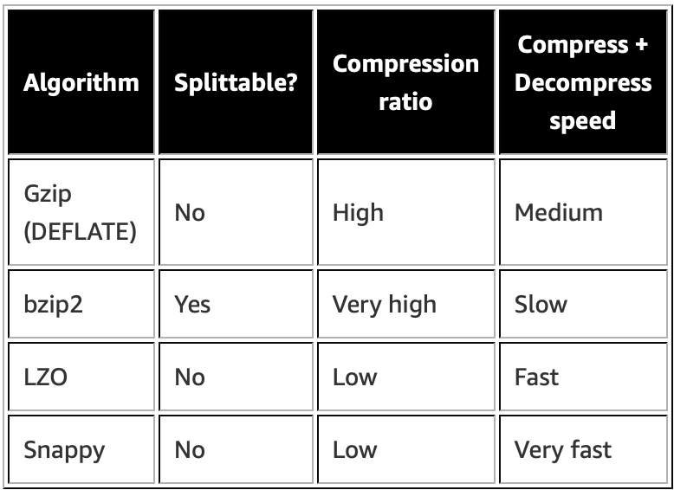
AWS Athena & Quicksight
Athena Best Practices
Partitioning/Bucketing the Data
Compress and Split the files – Parquet and ORC, bzIp2
Optimized columnar data store generation – Parquet and ORC
Optimize file sizes
Optimize Order_By queries – try using Limit if you need N top/bottom values
Optimize Joins – larger table on the left side of join and smaller on right side
Optimize Group_By queries
Highest cardinality first to the lower cardinality
Number instead of strings
SELECT state, gender, count(*) FROM census GROUP BY state, gender;
SELECT state, gender, count(*) FROM census GROUP BY 1, 2;

Slide 7
AWS Athena & Quicksight
Athena Federated Query
Payment processing in a secure VPC with transaction records stored in HBase on Amazon EMR
Redis to store active orders so that the processing engine can access them quickly
Amazon DocumentDB for customer account data such as email addresses and shipping addresses
A product catalog in Amazon Aurora for an ecommerce site that uses automatic scaling on Fargate
CloudWatch Logs to house the order processor's log events
A write-once-read-many data warehouse on Amazon RDS
DynamoDB to store shipment tracking data

Slide 8
AWS Athena & Quicksight
Use Case

Slide 9
AWS Athena & Quicksight
Demo
DEMO

Slide 10
AWS Athena & Quicksight
References
AWS Athena
Analyze Data on S3 – https://aws.amazon.com/blogs/big-data/analyzing-data-in-s3-using-amazon-athena/
Best Practices - https://aws.amazon.com/blogs/big-data/top-10-performance-tuning-tips-for-amazon-athena/
Writing a Federated Query – https://docs.aws.amazon.com/athena/latest/ug/writing-federated-queries.html
Documentation - https://docs.aws.amazon.com/athena/latest/ug/what-is.html
AWS Blog Posts on Athena - https://aws.amazon.com/blogs/big-data/tag/amazon-athena/
AWS Quicksight
Documentation - https://docs.aws.amazon.com/quicksight/latest/user/welcome.html
AWS Blog Posts on Quicksight - https://aws.amazon.com/blogs/big-data/tag/amazon-quicksight/

Slide 11
Thank You
We Are One Anthem

